Slide 1
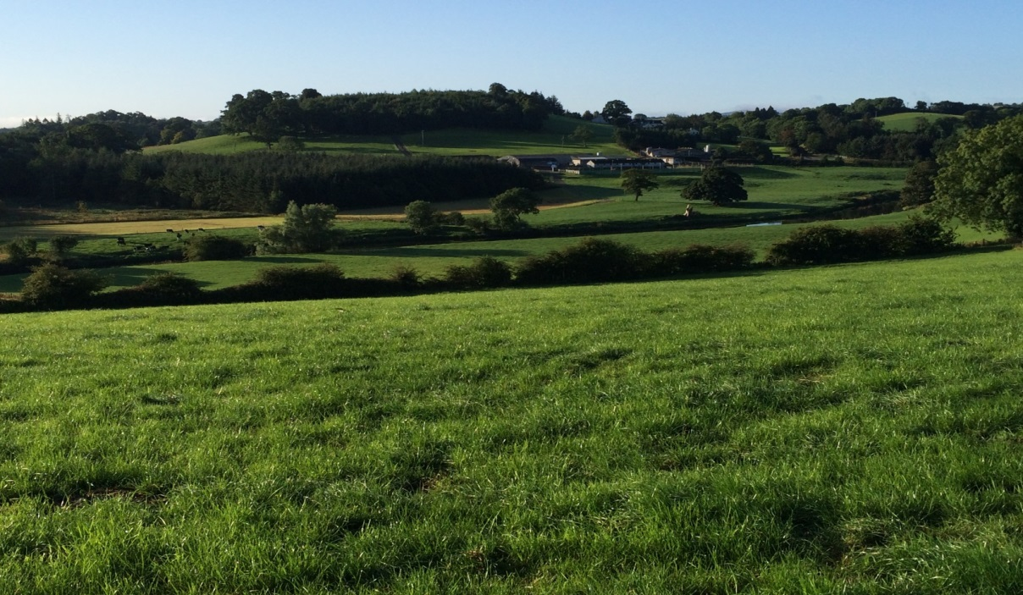
Ballyhaise Dairy Research 2018

Slide 2
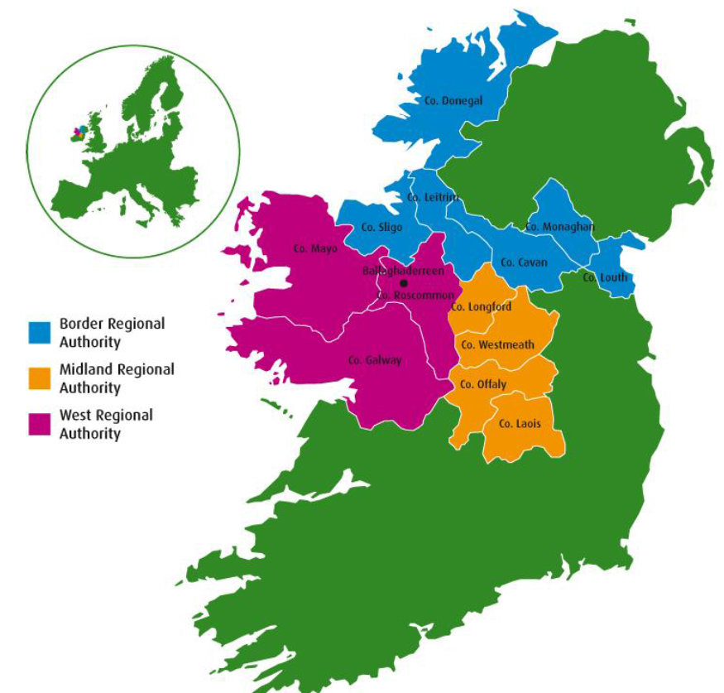
Rationale for Research Programme
BMW region accounts for 47% of land and 25% of milk produced (CSO, 2015)
NFS data suggests that farms in this region are less economically viable than other regions (O’Donoghue and Hennessy, 2014)
Previous studies have questioned the viability of milk production on wetland soils due to reduced grass production & utilisation, a short grazing season, increased supplementation and higher production costs (Shalloo, 2004; Lapple et al, 2012; Ramsbottom et al., 2015)
Table 2.1. Number of Active Dairy Herds by province (ICBF, 2013)
Teagasc Moorepark Dairy Research Centre
 | 2008 | 2009 | 2010 | 2011 | Change
Munster | 10,041 | 9,841 | 9,587 | 9,431 | -6%
Leinster | 3,945 | 3,851 | 3,784 | 3,698 | -6%
Connaught | 1,002 | 963 | 916 | 892 | -11%
Teagasc Ballyhaise Agricultural College

Slide 3
Project Objectives
To demonstrate best practice grassland management.
To develop highly profitable and sustainable systems of milk production for farmers in the BMW region.
To produce high quality research that will have a positive impact on the dairy industry within the BMW Region.
To disseminate this information through the local advisory structure, discussion groups, print media, social media etc.

Slide 4
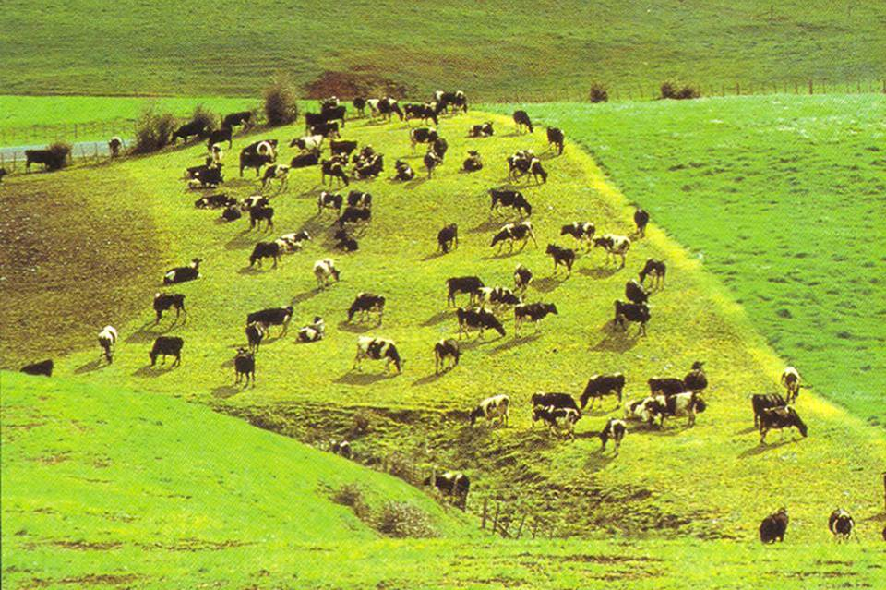
Stocking rate and Grass Utilisation
Profitability of Irish dairying is closely linked to grass utilisation (tons DM/ha)
  Increasing SR only profitable when grass utilisation (tonnes DM/ha) increases
Optimum Stocking rate for Dairy Farms in 2018
 | Pasture grown, t
t supplement DM/cow | 10 | 12 | 14 | 16
0.00 | 1.5 | 2.0 | 2.3 | 2.6
0.25 | 1.7 | 2.1 | 2.4 | 2.8
0.50 | 1.8 | 2.2 | 2.5 | 3.0
0.75 | 1.9 | 2.3 | 2.7 | 3.1

Slide 5
Our Competitive advantage
13.5 ton DM / ha
Excellent quality
Utilisation more challenging
Later calving date
Extra supplement
Early culling
Extra supplement

Slide 6
Ballyhaise Grass Production
Average production 13.7 tonnes DM / ha
Big Range 11 to 15.5 tonnes DM / ha

Slide 7
The Seasonal, Pasture-Based Milk Production System
Integrated/ ordered decisions
Alignment of grass supply & demand
Grazing Management Targets
Profitable/ Robust/ Sustainable
Based on 2013-2015 statistics | Ave. | Top 10% | Target
Est. grass growth (t DM/ha) | 10.0 | 13.0 | 16.0
Grazing season length (days) | 223 | 251 | 276
Grazing days per hectare | 446 | 577 | 801
Est. grass utilisation (t DM/ha) | 6 - 8 | 8 - 10 | 12 - 14
285+ DIM
Suitable cows
Suitable management

Slide 8
Ballyhaise Herd Fertility

Slide 9
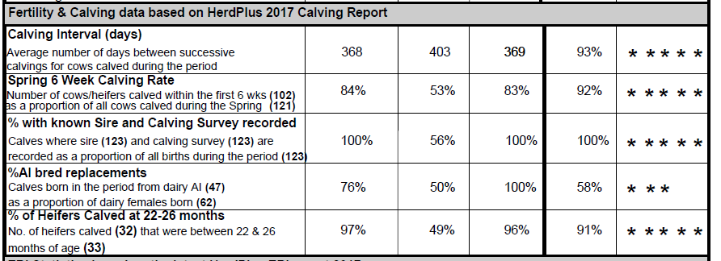
Fertility Performance 2017

Slide 10
Ballyhaise System

Slide 11
Ballyhaise Targets
Peak Oct 1st:
1,150 kg DM/ha
Turnout Feb 15th
850 kg DM/ha
Housing Nov 10th
650 kg DM/ha
Magic day April 15th:
500 kg DM/ha
Notes:
From the 1st of October until the 5th of April (6 months) Grass demand is greater than supply.
A budget is basically a plan of how the herd can be fed during this period.
Any budget is pointless unless it affects your day to day decisions.
Once the cover targets are in place your job is to stay as close as possible to the target line.
It helps you to focus on the overall farm situation and not just on the individual paddock.
We start with what cover we want on the farm on magic day and work backwards.

Slide 12
Closing and Opening Covers
Essential to carry some high pre-grazing herbage into winter
Target AFC 600kg – 650kg DM/ha at closing
Average overwinter growth is 1.5 kg DM / ha per day
Closing on the 5th of October is too late (25th of September)
70% grazed by 1st of November
Notes:
Over the past five years we have revised our closing cover target – as our stocking rate has increased and our calving pattern has become more compact we have started to carry more grass over winter.
Because overwinter growth is low we need to close at a min of 600 cover to ensure an adequate opening cover in spring
To achieve this we have to start closing paddocks on the 25th of September.
Closing at these higher covers does not have a negative impact on over winter growth
In fact in 2010 which was a very severe winter farm cover still increased even though we closed close to 600.
Getting the last rotation and closing cover right has a major impact on feed costs in the following spring.
Budgeting has helped us to identify these issues and adapt our management to combat them.

Slide 13
Farm Fragmentation
Supplements required
HO: SR
4.5 cows/ha
Additional Grass
Grazed grass
HC: SR
3.1 cows/ha

Slide 14
Self sufficient systems
34 c/l
29 c/l
24 c/l

Slide 15
Dairy Unit 2018
Land
40 ha milking platform
Farm divided into 4 experimental farmlets
Well serviced with roads
Soil fertility
  PH – 95% Optimum
  P – 90% Optimum
  K – 55% Optimum
20% prone to flooding

Slide 16
Grazing days per ha and Grass Utilisation
Grazing days/ha is a key biological measure of grass utilisation (1 day/ha = 10-15 kg DM)
SR x Grazing season length
Notes:
16

Slide 17
Background
To increase grazing days per hectare you can:
  Increase overall farm stocking rate
  Increase grazing season length
  Increase both a) and b)***
Stocking rate (LU/ha) | 2.5 | 2.9
Grazing season length (days)
Mid- march to Mid-October (210 days) | 500 | 600 (+20%)
Mid-February to Mid-November (270 days) | 700 (+40%) | 800 (+60%)
In addition, there are carryover effects on:
  Pasture production, quality & utilisation
  Animal intake and performance
  Overall farm Economic Performance
Notes:
17

Slide 18
Experimental Groups
 | AV LSR | AV HSR | EX LSR | EX HSR
Days at grass (days) | 210 | 210 | 270 | 270
Stocking Rate (cows / ha) | 2.5 | 2.9 | 2.5 | 2.9
Yellow – Average grazing season low Stocking rate
Blue – Average grazing season high Stocking rate
Green – Extended grazing season low Stocking rate
Red - Extended grazing season high Stocking rate

Slide 19
Grazing Season 2017
 | AV LSR | AV HSR | EX LSR | EX HSR
Turnout by day | 22nd March | 22nd March | 13th Feb | 13th Feb
Turnout by night | 1st April | 1st April | 13th Feb | 13th Feb
On-off Grazing (days) | 0 | 0 | 18 | 18
Finished 1st rotation | 25th April | 25th April | 15th April | 15th April
Housed by night | 25th October | 25th October | 10th Nov | 9th Nov
Housed Full time | 28th October | 28th October | 10th Nov | 11th Nov
Days grazing per cow | 209 | 209 | 262 | 259
Days grazing per ha | 523 | 607 | 655 | 751

Slide 20
Grass Production
Treatment | AV LSR | AV HSR | EX LSR | EX HS R
Cumulative Growth (Kgs/DM/Ha/Year) | 14.6 | 15.0 | 14.9 | 15.5
Silage Conserved (Kg/ DM/Cow) | 1413 | 1350 | 1330 | 1240
Silage self sufficient (%) | 79 | 71 | 100 | 93

Slide 21
Feed Inputs
Treatment | AV LSR | AV HSR | EX LSR | EX HS R
Concentrate (kg/cow) | 594 | 585 | 477 | 500
Grass Silage (kg/DM/Cow)
During Lactation | 923 | 1,044 | 365 | 476

Slide 22
Milk Production 2017
Treatment | AV LSR | AV HSR | EX LSR | EX HSR
Milk Yield (kg / cow) | 5,174 | 5,082 | 5,104 | 5,194
Fat (%) | 4.94 | 5.01 | 5.16 | 5.07
Prot (%) | 3.74 | 3.73 | 3.84 | 3.78
Lactose (%) | 4.98 | 4.96 | 4.92 | 4.90
Milk solids (kg / cow) | 447 | 445 | 459 | 459
Milk solids (kg / ha) | 1,117 | 1,290 | 1,147 | 1,331

Slide 23
Conclusions to date
Grass production was similar in 2017
Production per cow was similar
More concentrate feed was feed in average grazing season treatments
Extended grazing groups were self sufficient for silage where average groups were short winter feed.

Slide 24
Profitability
Average costs - €2.58 / kg MS
Average profit - €1.93 / kg MS
Farm profit - €88,000 (€2,200/ ha)

Slide 25
Conclusions
Highly profitable grass based systems are possible in Region
Heavy soils complicates grazing management and requires flexible approach
€1,000 per acre profit possible if basics are right
High grass production, long grazing season, high EBI herd, compact calving.

Slide 26



Acknowledgements:
Ballyhaise College Staff for their care of experimental animals
Local dairy farmers and processors for their financial support through expanded National Dairy Levy
Weekly updates on Ballyhaise farm available at:
http://www.agresearch.teagasc.ie/moorepark

